Slide 1
Predicting Protein-Molecule binding affinity using Machine learning
Author: Anatoly Buchin

Slide 2
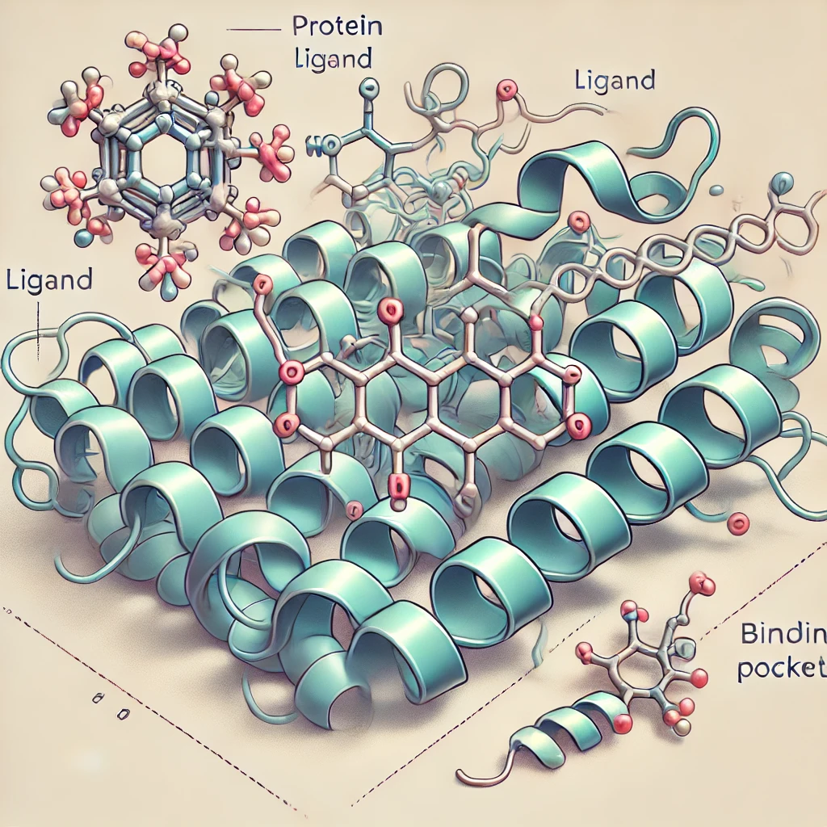
Problem statement
Classical drug discovery problem:
Predict all ligands that could bind to the given target, based on target and ligand properties.
Objective: Predict binding affinity between protein-molecule pairs.
Data Provided: UniProt and PubChem IDs for confirmed binding pairs measured by kiba_score.
Challenge: need external data for features and synthetic negative examples.

Slide 3
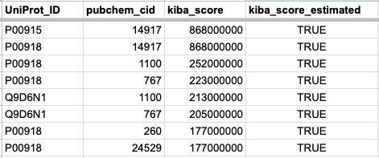
Problem statement
Provided dataset
Objective: Predict binding affinity between protein-molecule pairs.
Data Provided: UniProt and PubChem IDs for confirmed binding pairs measured by kiba_score.
Challenge: need external data for features and synthetic negative examples.
Proteins
Ligands
Binding
Measurement

Slide 4
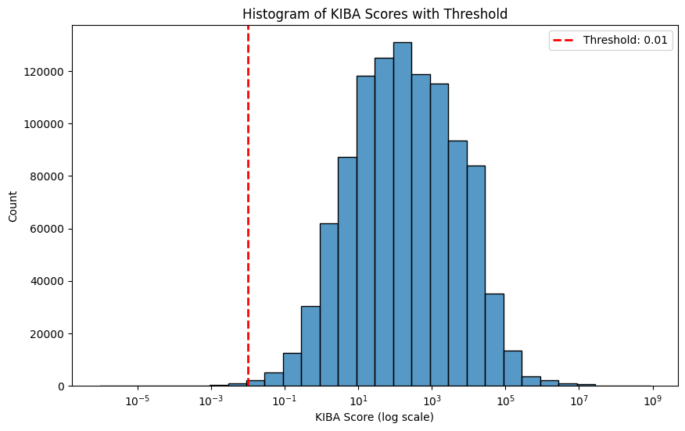
Data preparation
KIBA score distribution
Data interpretation: positive kiba_score (>0) means binding
Observation bias: if ligands were not bound, their kiba_score was not recorded (positive sampling bias)
Solution: random shuffling of Uniprot_ID and pubchem_cid to obtain negative samples.
Caution: we should avoid random co-occurrences after shuffling (removed)

Slide 5
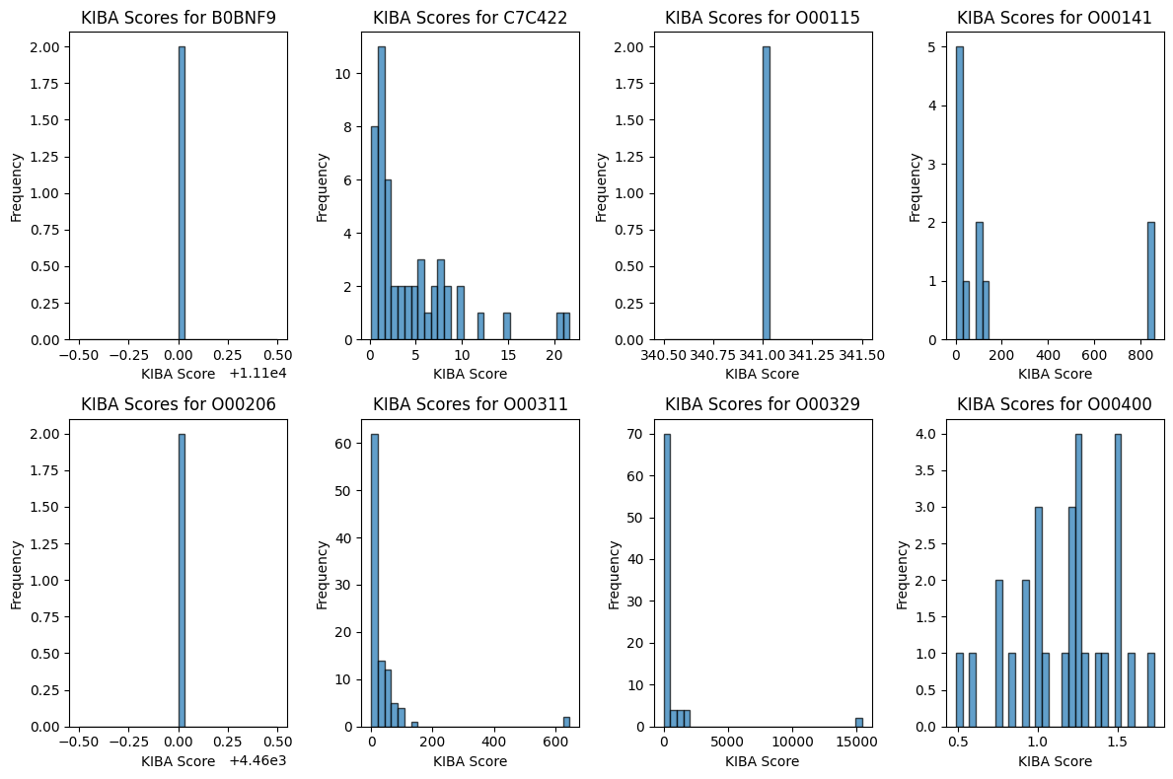
Data cleaning
KIBA score distribution for proteins
Problem: data has duplicates
Solution: take an average for Uniprot_ID x pubchem_cid pair.
Assumption: every duplicate value is an experiment -> perform the average for all duplicates

Slide 6
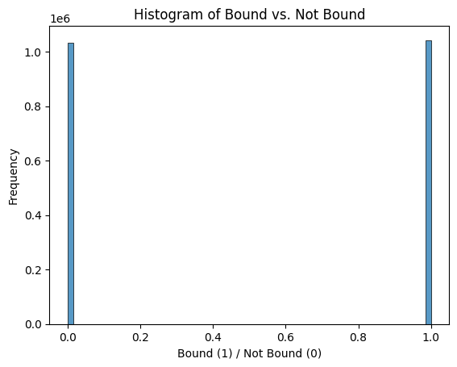
Balancing the training dataset
Distribution of kiba_scores in combined dataset
Problem: after combination of positive (kiba_score>0) ang negative (kiba_score<0) values the dataset becomes unbalanced.
Solution: form dataset with positive and negative examples well balanced.
0 - not bound (kiba_score=0)
1 - bound (kiba_score>0)

Slide 7
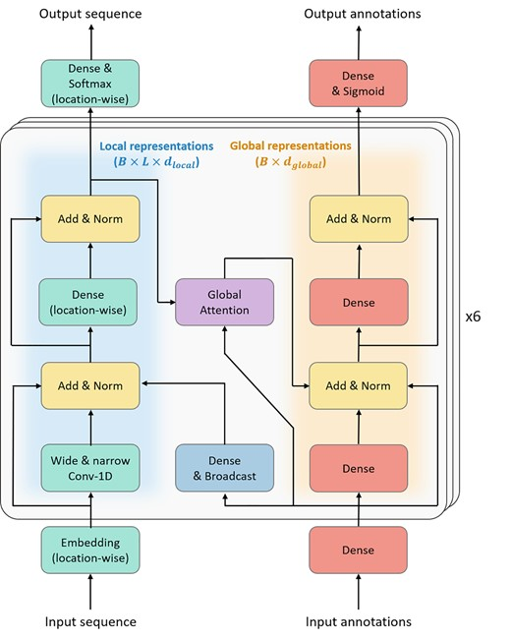
Feature engineering: proteins
Prot-Bert
Problem: how to represent the molecular structure of proteins from UniProt_ID?
Solution: use low-dimensional embedding from Prot-Bert Model. Every protein is 1024 vector.
Caution: inference of the model is slow, so we are using pre-computed embeddings from kaggle.
If protein is not present -> compute embeddings using Prot-Bert model.
UniProt_ID -> Sequence ->
1024
vector
Brandes et al 2022

Slide 8

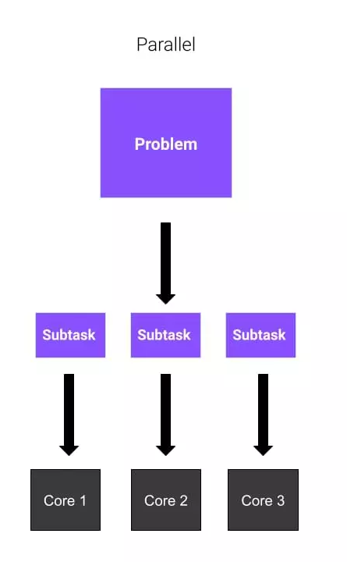
Feature engineering: ligands
Problem: how to represent ligands from using pubchem_id?
Solution: use rdkit to extract ligand features. We use molecular fingerprints, polar surface area and many other features.
Caution: python API is very slow for ~650K ligands, I have engineered solution based on SMILES representation. Mapping for pubchem_id x SMILES.
pubchem_cid -> SMILES ->
-> features
Data processing
~650K ligands
Batch-processing
Parallel processing

Slide 9
Formulation of ML problem
Combining protein + ligand features
Protein features
Ligand features
Outcome
Data: protein, ligand features
Target: outcome is binary (1 - bound, 0 -not bound)
Models: Random Forest, Logistic Regression, XGBoost, 2 layer Neural network
Metrics: accuracy, confusion matrix, recall and f1 score
0
1
1
0
…
~1024 features
(Prot-Bert)
~2200 features
(RDkit)

Slide 10
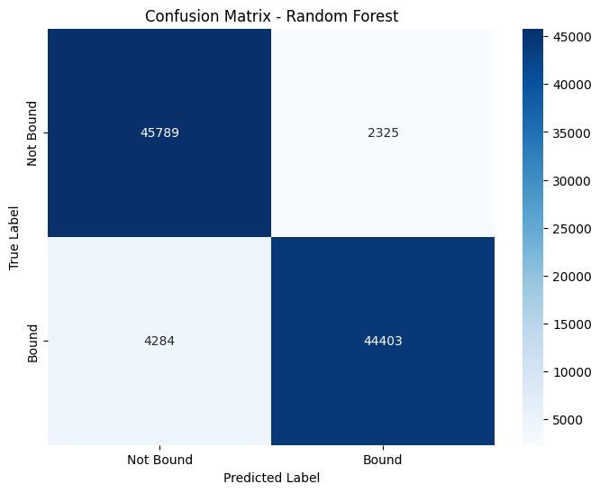
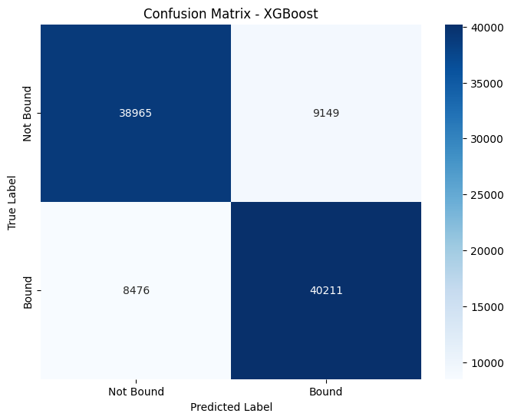
High performing models
Random forest is the best model
Random forest
Accuracy: 93% Recall: 93%
Chance: 50%
XGBoost
Accuracy: 82% Recall: 82%
Chance: 50%

Slide 11
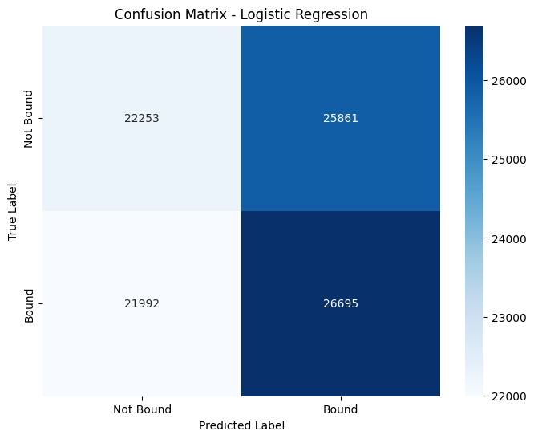
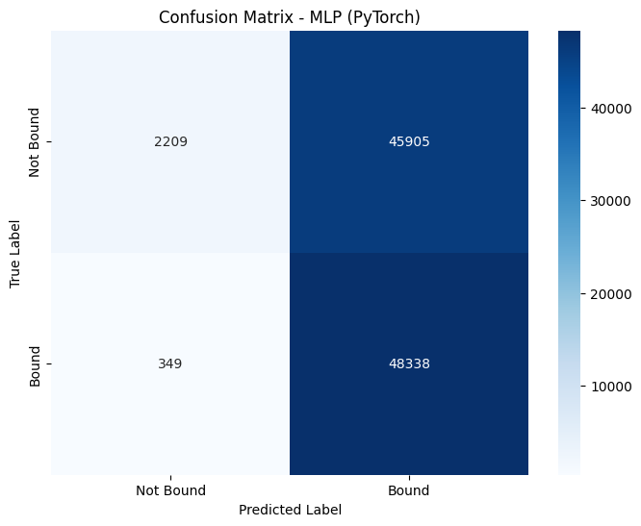
Low performing models
Logistic regression
Accuracy: 50% Recall: 50%
Chance: 50%
2 layer Neural network
Accuracy: 52% Recall: 50%
Chance: 50%

Slide 12
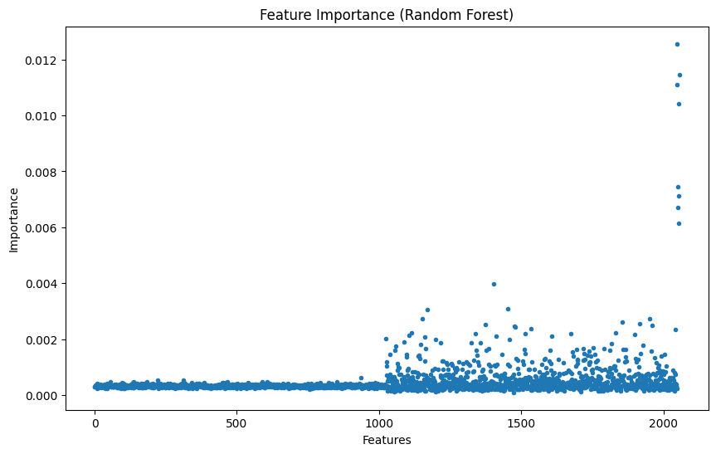
Feature weights of the best classifier
Observations
Ligand features have high weights for classification performance
Protein features from Prot-Bert have lower weights
Ligand features
Protein features

Slide 13
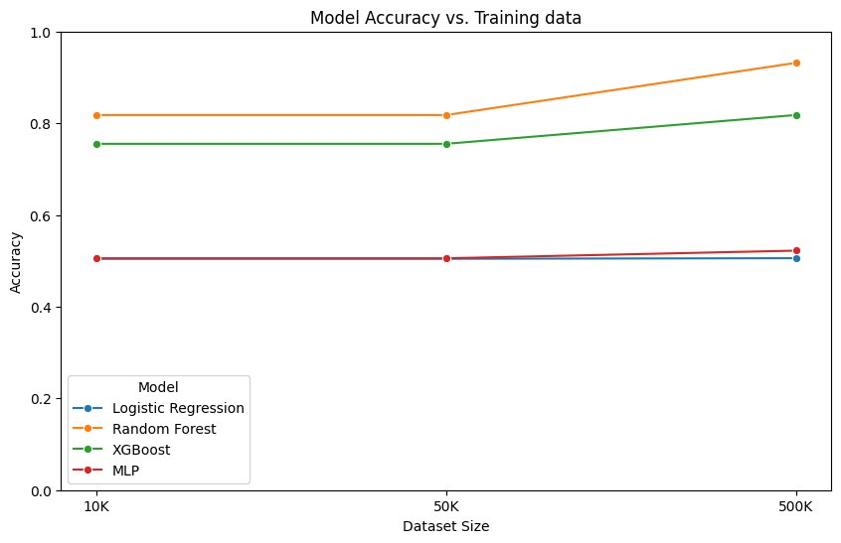
Model performance improves for larger sample sizes
Observations
Random forest and XGBoost performance improves for larger sample sizes
Logistic regression and 2 layer neural network (MLP) does not significantly improve for larger samples

Slide 14
Conclusions
Random forest
Accuracy: 93% Recall: 93%
Chance: 50%
Random forest is the best model we tested for predicting the protein-to-ligand binding problem with 92% accuracy of prediction based on test set performance.
Combined protein (Prot-Bert) and ligand (RDkit) representations of molecules could be used to predict their binding affinity.

